Slide 1
Open Innovation Challenge – IV Monitor underground water pipeline water quality and identify leaks Bishik, Nihad, Rijo, Chandan, Abhay, Purushotham, Gurjeet, Ismail.
This slide does not contain any export regulated technical data

Slide 2
Contents
Problem or challenge identified
Technology solution proposed
Solution architecture
Investment and Time-line
Help Needed
Profile of Team Members

Slide 3
Problem or challenge identified
Problem identified :
Though the municipal water is properly processed for drinking, the water might get contaminated due to leaks when flowing in underground pipelines to the residential houses.
If there is a leak at any location of underground water pipeline, it is unidentified in the current architecture.
Drinking water is wasted and contaminated . The consumption of the same leads to diseases.
The current architecture of Ground water pipelines is shown in next slide.

Slide 4

Problem or challenge identified
Current Architecture
H-5
H-3
H-1
Leak
(Unidentified)
Cabin
Main Water line
H-7
H-6
H-4
H-2
House
H-8

Slide 5
Technology solution proposed
The idea is to check the water leak using pressure sensors and flow-rate sensors. The quality of water is checked using Multiparameter-sondes or P_{h} sensors.
Collect data from the sensors to analyze and take appropriate actions to notify the concerned authorities about the leak and its approximate location (range in which the leak has occurred).
This will be done using mathematical bisection method of finding the root (i.e., location) using the pressure, velocity and Flow rate profile equations.
Solution:
Retrofit the underground pipe lines with Pressure, Flow-meter and P_{h} sensors to collect the Flow rate Q ( Lit/min) , P,V via Wi-fi router. Store the data in Server, process that data and take appropriate actions.
The pipe lines in residential apartments, corporate offices, high raised buildings, oil transportation sector can also be the target customers for this product.

Slide 6

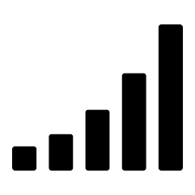
Technology solution proposed (Schematic View)
The sensors will be installed at point just after the Inlet (Cabin). The data from this sensor will serve as the source for our data analysis.
Other sensor units will be installed at the sumps of households. This data will be run through algorithms to identify the leak, its location and the quality of water.
Action
Data Processing
H-5
H-3
H-1
1
Server
Q_{L}
Data
Data
Data
Leak
Main Water line
H-7
Data
Cabin
H-6
Data
H-4
Data
H-2
Data
Data
Sensors
H-8
Proposed Architecture
Data

Slide 7
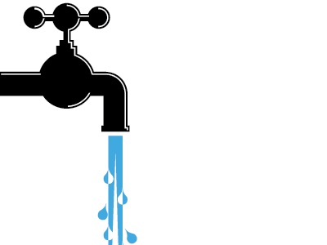
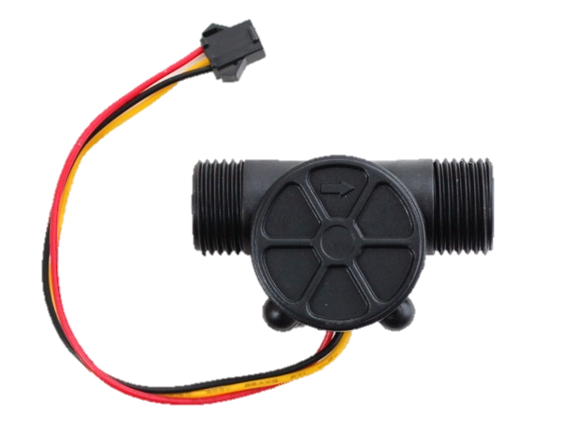

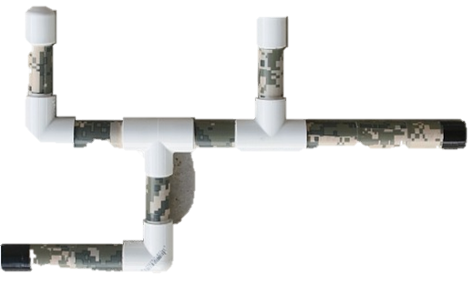
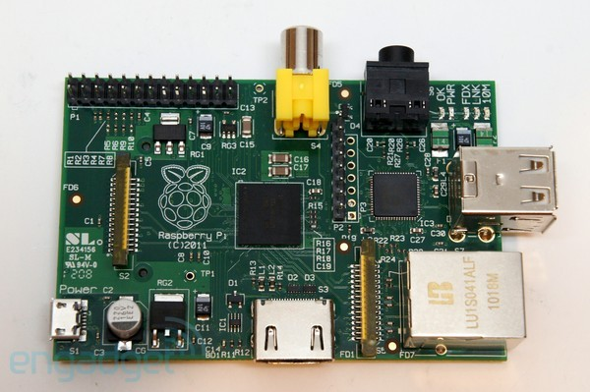
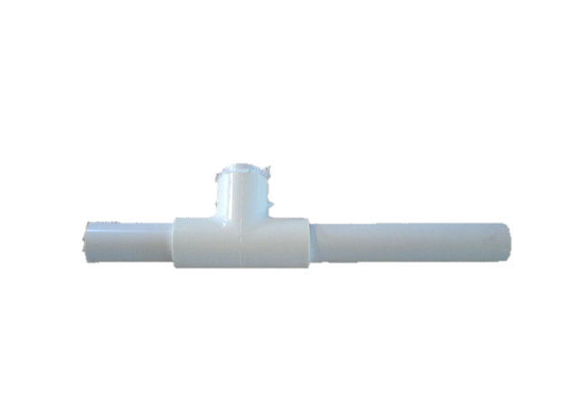

POC Implementation
Q₃
Raspberry pi
Q
Wi-fi
Q₂
Q₁
Data Processing
Action (Notification)
Google Drive
POC Architecture

Slide 8
POC Implementation
What we use to build the POC:
PVC pipes of dia. 1.5”, flow-meter of dia. 1.5” ,P_{h} sensor, control valve, to build a closer replica (prototype) of the real water pipelines. Other Sensors, dongle and Raspberry pi will also be used in our set-up.
The data from the sensors will be transferred via internet from Dongle and stored in Google drive. Further processing will be done in MS Excel and actions to carried out will be scripted in VBA macros.
Leak identification mechanism:
A leak will be created intentionally at a particular location on the PVC pipe and the calibrated data from the sensors like Flow rate (Q), Pressure (P), P_{h}, Velocity (V) will be transmitted to Google drive via internet from the Dongle.
This data will be analysed using principle of Continuity of Fluids (Q=Q1+Q2+Q3 i.e., sum of flow rates at Q must be equal to flow rates Q1, Q2, Q3)
This equation will be violated. Hence, mathematically, we conclude that there is a leak.
Mathematical iterations will be done to find out the approximate location of leak based on the CFD data (using Bisection method) .
The location, thus obtained, will be validated with the location of the intentional leak. Iterations will be done till the calculated location matches the actual location of the leak.
Where we build and test the prototype:
Tap water in Cafeteria 2nd floor or Near Volley ball court.

Slide 9
Solution architecture (Hardware and Software)
Raspberry pi
Sensors and Data collection:
Flow-meter Sensors
Pressure Sensors
Velocity Sensors
Raspberry pi
Communication and data storage:
Wi-fi Router
Google Drive or Box (for POC)
Wi-fi

Slide 10
Solution architecture (Hardware and Software)
Data analysis:
MS Excel (for POC)
VBA Macros
Mathematical bisection model.
Analysis: Once the flow rate, pressure and quality of water are collected in the Google drive, the data will be transmitted to the machine for processing. The processor checks the above data across each water flow line and identifies if there are any leaks. Similarly, data relating to the quality of water is analyzed and compared to standard P_{h} factor.
Principle:
By principle of Continuity of Fluids:
Q=Q₁+Q₂+Q₃ →
1
Data Processing
Google Drive

Slide 11
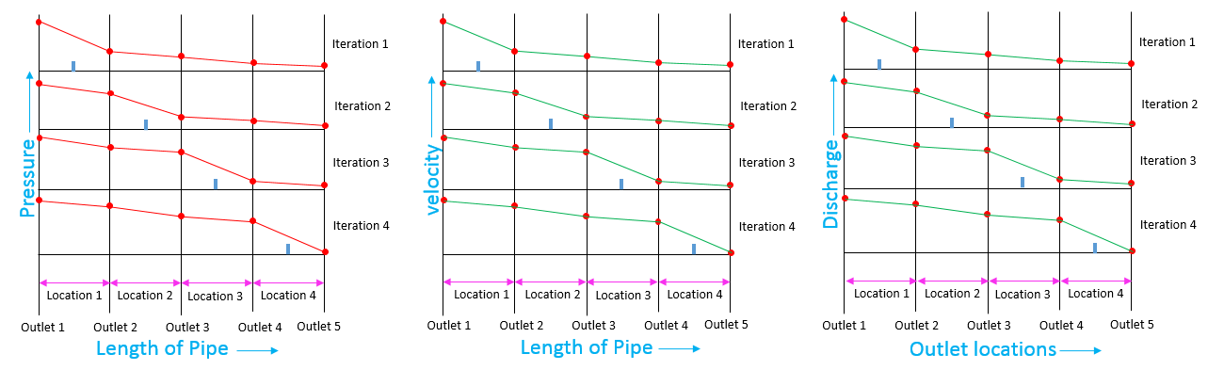
Solution architecture
Simulate the flow in the pipes and plot Pressure vs Length, Velocity vs length and discharge vs output loc. by varying the area and location of the leak.
For each area A1, A2, A3 etc. Pressure and velocity vs length would be plotted by simulating leak in pipe line at each of the locations of the pipe as shown below.
Comparing the actual pressure, Velocity and flow-rate readings with the graphs plotted by simulation, location of the leak can be identified.

Slide 12
Solution architecture (Hardware and Software)
Action
SMS
Notification to concerned authorities.
After identifying the magnitude of leak, the approximate location and quality of water, the same data will be transmitted to the concerned authorities to take the necessary decisions via SMA or mail.
Data Processing
Action (Notification)
Google Drive

Slide 13
Investment and Time-line
Investment
Timeline

Slide 14
Help Needed – Hardware, Software, Technology
Hardware:
Pipes and fittings.
Sensors and Raspberry pi from Cyient IOT lab.
Infrastructure for building the prototype and storing it.
Internet connectivity.
Software:
Python.
ANSYS for CFD.

Slide 15
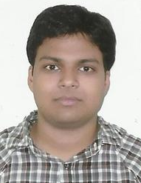
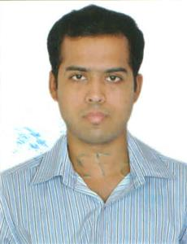
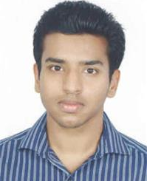
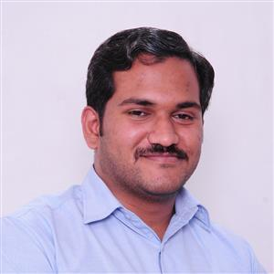

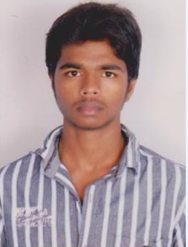
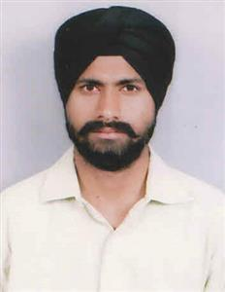
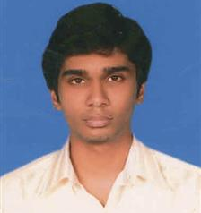
Team members profile
Bishik Pal
AandD-UTC-SOFT-ELECT-APP SW-UTAS India
Manikonda Tower-1,GC
Hyderabad, India
Nihad Ahmed
AandD-UTC-SOFT-ELECT-APP SW-UTAS India
Manikonda Tower-1,GC
Hyderabad, India
Rijo Abraham
AandD-UTC-DESIGN and DRAFTING-EMERGING ACCOUNTS
CentralTower-3A
Hyderabad, India
Chandan Godhi
AandD-UTC-DESIGN and DRAFTING-PWC India
Electronic City,
Hosur Main Road,
Bangalore,
India
Gurjeet Singh
AandD-UTC-DESIGN and DRAFTING-EMERGING ACCOUNTS
Manikonda Tower-1,3A
Hyderabad, India
Ismail Mohammed
AandD-UTC-DESIGN and DRAFTING-EMERGING ACCOUNTS
Central Tower-3A
Hyderabad, India
Abhay Paropkari
AandD-UTC-DESIGN and DRAFTING-EMERGING ACCOUNTS
Central Tower,3A
Hyderabad, India
Purushotham Singh
AandD-UTC-SYSTEMS and ANALYSIS-PSA-PWA India
Central Tower-1,3C
Hyderabad, India

Slide 16
Summary
Drinking water plays a key role in the health of individuals. Fatal deaths have been recorded in India because of impure water consumption. Some actions are required to curb this.
Having said that, not everyone can afford costly RO purifier plant, a model which can make the existing system a better one is the need of the day.
This models directly helps the concerned Municipal authorities in identifying the leaks and reduce the inconvenience of the individuals in reporting the problem with the authorities.
Using mathematical models, various computations and the technology at our disposal, we have come up with an idea to help curb the loss as well as the contamination of the drinking water.

